Slide 1
Semi-supervised learning

Slide 2
Semi-supervised Learning
Supervised learning
You have labeled data
Unsupervised learning
You have no labeled data

Slide 3
Semi-supervised learning
You have some labeled data and many unlabeled data
Should you through away the unlabeled data ?

Slide 4
Supervised learning
Building a classifier using both labeled and unlabeled data

Slide 5
Why Semi-supervised learning
Unlabeled data is cheap
Labeled data can be hard to get

Slide 6
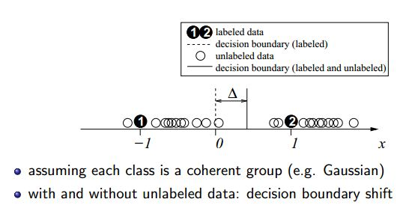
Semi-Supervised Learning
Takes benefits of both the Supervised and Unsupervised learning in some aspects
Does unlabeled data always help ?

Slide 7
Application
Natural Language parsing
Speech Analysis
Text Classification

Slide 8
Semi-Supervised Learning
Inductive learning
Output a prediction function defined on the entire input space
Labeled data, unlabeled data and test data
Transductive learning
Performing prediction only on unlabeled test data
Labeled data and unlabeled test data

Slide 9
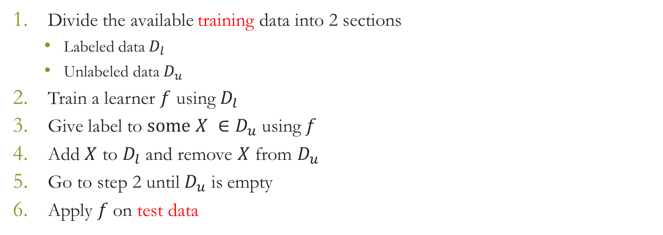
Self-learning
Also known as self-labeling/decision-directed learning
At each step 10% of the total unlabeled data are given label

Slide 10
Variations of self-learning
Add a few most confident unlabeled data to labeled data
Add all the unlabeled data to labeled data
Add all the unlabeled data to labeled data, weigh each by confidence

Slide 11
Self-learning
Advantages
Simplest semi-supervised learning method
Suitable for many real tasks
Disadvantages
Early mistake may show the wrong way
Cannot say too much about convergence

Slide 12
Performance Evaluation

Slide 13
Cross Validation
Test data should not be used for any
Parameter tuning
Type of generalization error

Slide 14
Cross Validation
K-fold cross validation
Leave-one-out cross validation

Slide 15
Ensemble Methods

Slide 16
Summary of Ensemble Methods
Bagging
Random Forests
Boosting

Slide 17
Bagging
Bagging predictors is a method for generating multiple versions of a predictor and using these to get an aggregated predictor.
The aggregation averages over the versions when predicting a numerical outcome and does a plurality vote when predicting a class.
The multiple versions are formed by making bootstrap replicates of the learning set and using these as new learning sets.
That is, use samples of the data, with repetition
Tests on real and simulated data sets using classification and regression trees and subset selection in linear regression show that bagging can give substantial gains in accuracy.
The vital element is the instability of the prediction method. If perturbing the learning set can cause significant changes in the predictor constructed then bagging can improve accuracy.

Slide 18
Bagging
Generate “bootstrap” replicates of training set by sampling with replacement
Learn one model on each replicate
Combine by uniform voting

Slide 19
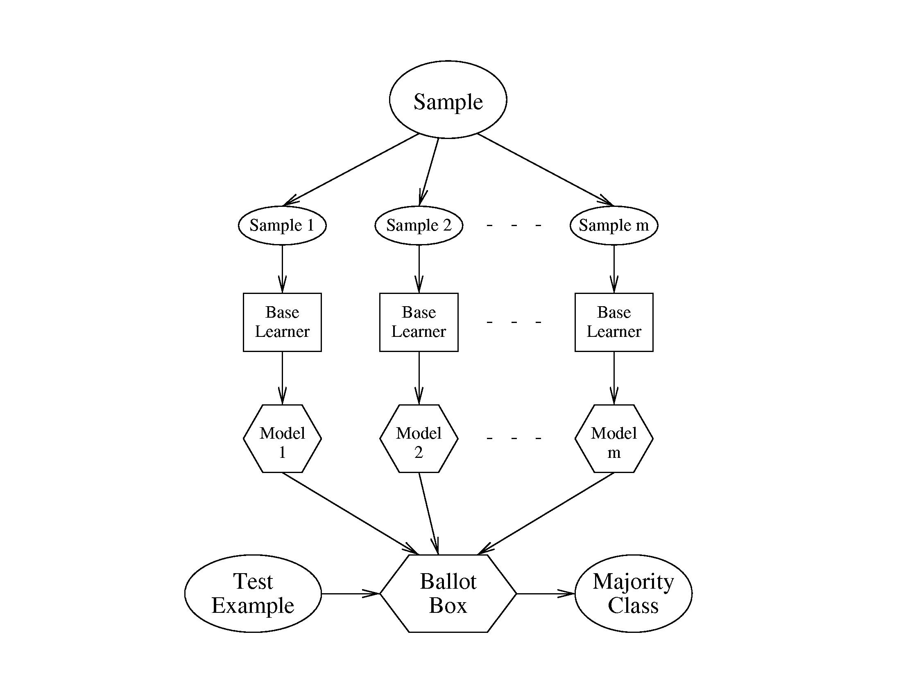

Slide 20
Example: Bagged Decision Trees
Draw 100 bootstrap samples of data
Train trees on each sample → 100 trees
Average prediction of trees on out-of-bag samples
…
Average prediction
(0.23 + 0.19 + 0.34 + 0.22 + 0.26 + … + 0.31) / # Trees = 0.24

Slide 21
Random Forests (Bagged Trees++)
Draw 1000+ bootstrap samples of data
Draw sample of available attributes at each split
Train trees on each sample/attribute set → 1000+ trees
Average prediction of trees on out-of-bag samples
…
Average prediction
(0.23 + 0.19 + 0.34 + 0.22 + 0.26 + … + 0.31) / # Trees = 0.24

Slide 22
Boosting
Initialization:
Weigh all training samples equally
Iteration Step:
Train model on (weighted) train set
Compute error of model on train set
Increase weights on training cases model gets wrong!!!
Typically requires 100’s to 1000’s of iterations
Return final model:
Carefully weighted prediction of each model

Slide 23
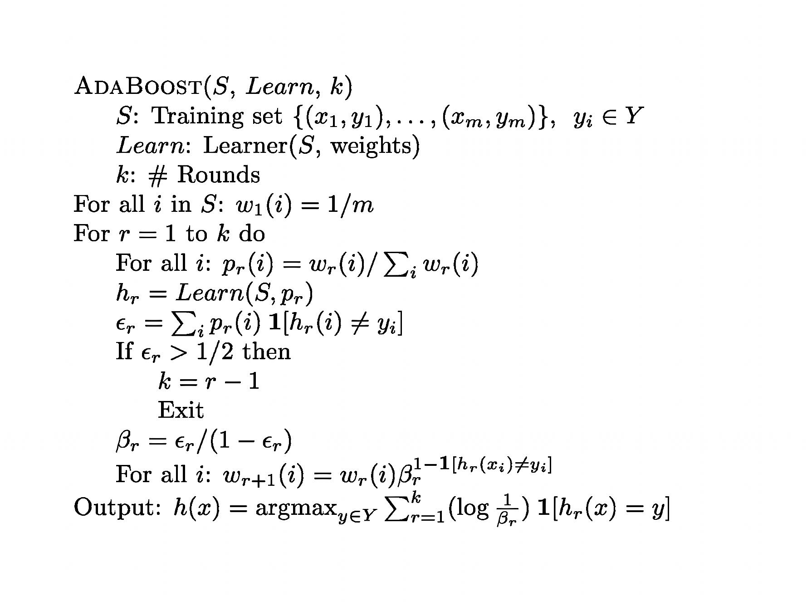
Adaptive Boosting (AdaBoost)

Slide 24
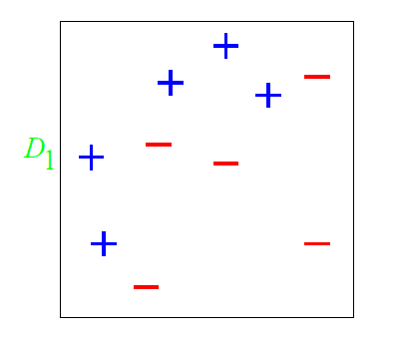
A Toy Example

Slide 25
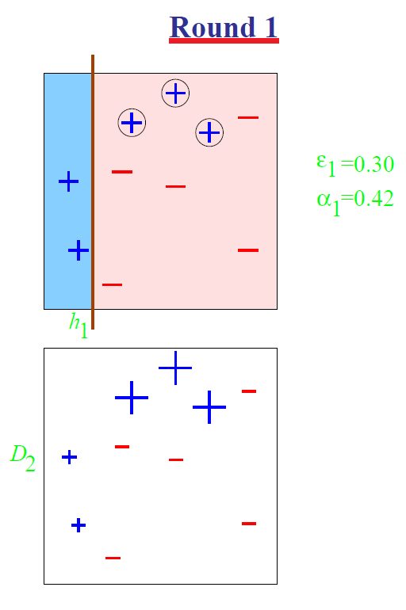
A Toy Example

Slide 26
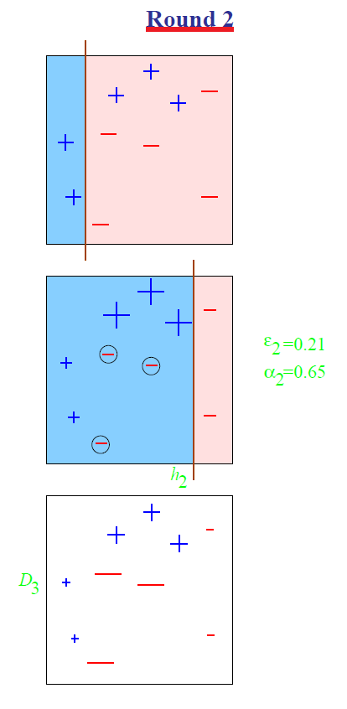
A Toy Example

Slide 27
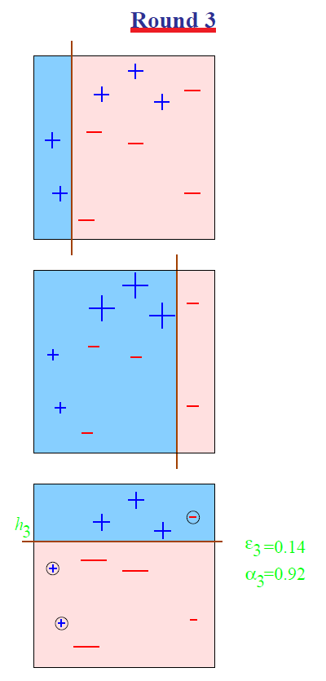
A Toy Example

Slide 28
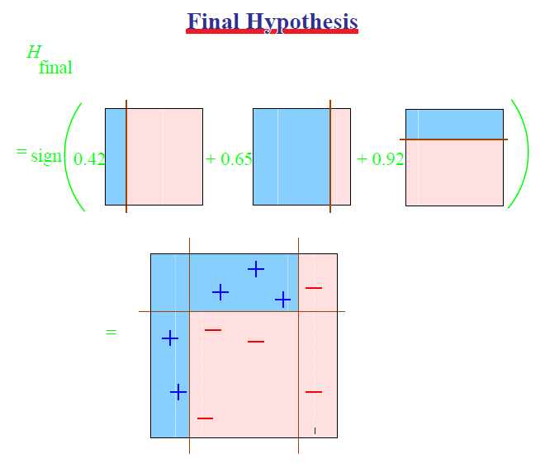
A Toy Example

Slide 29
References:
Semi-Supervised Learning (Chapter 1) by Olivier Chapelle,
Bernhard Scholkopf and Alexander Zien (from Page 1 toPage 4, before section 1.2)
Lecture slide on Boosting by Prof. Dan Roth
Wikipedia

Slide 30
Theoretical Machine Learning

Slide 31
Learning from Data
Learning from data
Used in situations where we may not have analytical solution but we have data to build an empirical solution

Slide 32
Problem Setup
An example
Netflix movie recommendation system
There is no magical formula but we have data
The task was to predict how a viewer will rate a movie
10% improvement = 1 million dollar prize !!

Slide 33
The essence of Machine Learning
A pattern exists
We can not pin it down mathematically
We have data on it

Slide 34
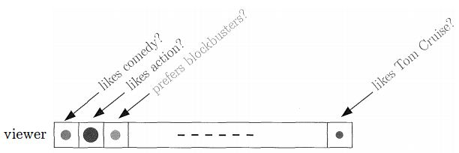
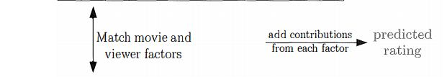
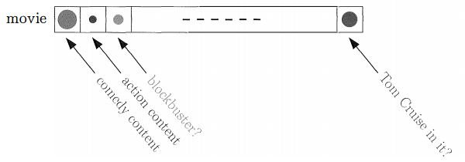
What is done?
We build
Viewer characteristic
Movie characteristic
We recommend

Slide 35
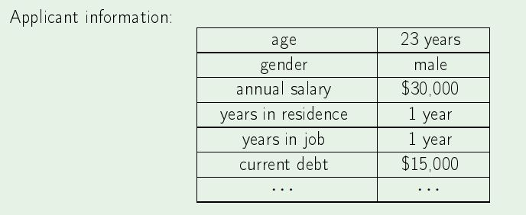
Components of learning
Credit approval
Approve credit ?

Slide 36
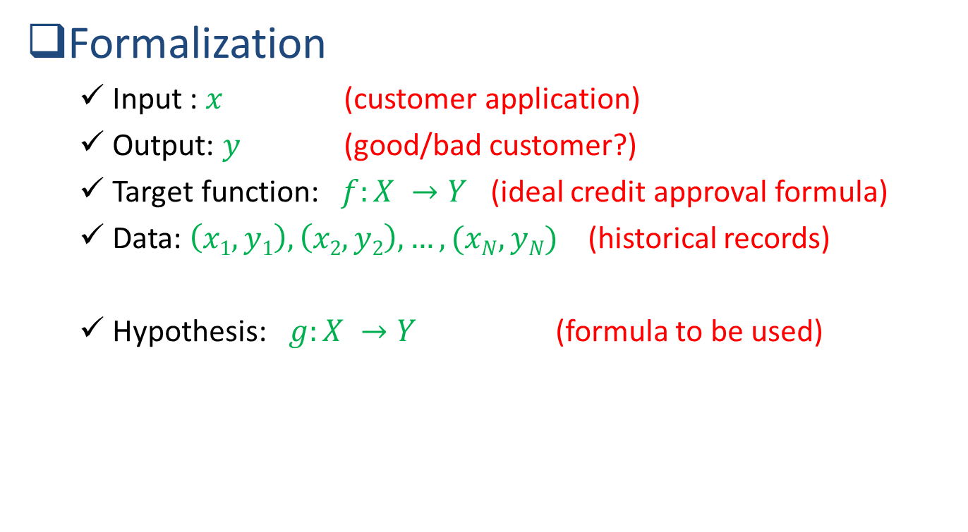
Components of learning
Formalization
Input : $x$ (customer application)
Output: $y$ (good/bad customer?)
Target function: $f:X →Y$ (ideal credit approval formula)
Data: $\left(x1,y1\right), \left(x2,y2\right), …, (xN,yN)$ (historical records)
Hypothesis: $g:X →Y$ (formula to be used)

Slide 37
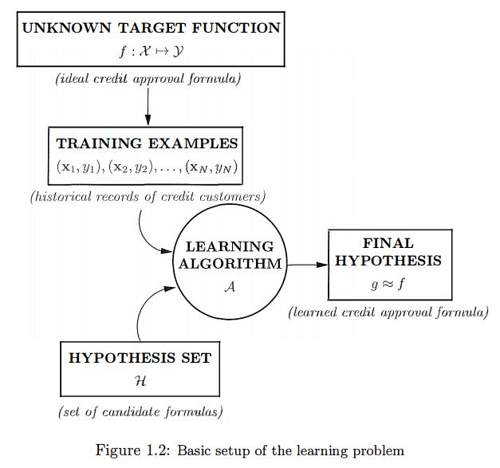
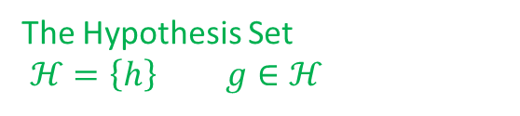
Solution Components
The Hypothesis Set
$ℋ=\left\{h\right\} g∈ℋ$
Learning Model
The Learning Algorithm

Slide 38
Thank you ☺
Reference:
Learning from Data-
Yaser S. Abu-Mostafa
Malik Magdon-Ismail
Hsuan-Tien Lin

